Slide 1
Numerical Methods
Solution of Ordinary Differential Equations

Slide 2
Solve Ordinary differential equation (ODE) problems.
Appreciate the importance of numerical method in solving ODE.
Assess the reliability of the different techniques.
Select the appropriate method for any particular problem.

Slide 3
Computer Objectives of Unit 7
Develop programs to solve ODE.
Use software packages to find the solution of ODE

Slide 4
Solution of ODE
Introduction to Ordinary
Differential Equations (ODE)

Slide 5
INTRODUCTION
Recall basic definitions of ODE,
  order,
  linearity
  initial conditions,
  solution,
Classify ODE based on( order, linearity, conditions)
Classify the solution methods

Slide 6
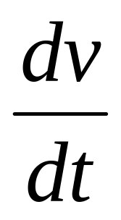
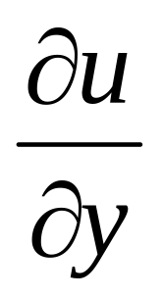
Derivatives
Derivatives
Ordinary Derivatives
v is a function of one
independent variable
Partial Derivatives
u is a function of
more than one
independent variable

Slide 7
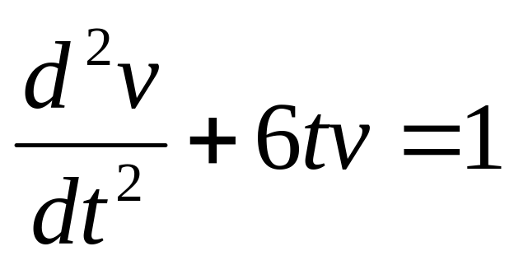
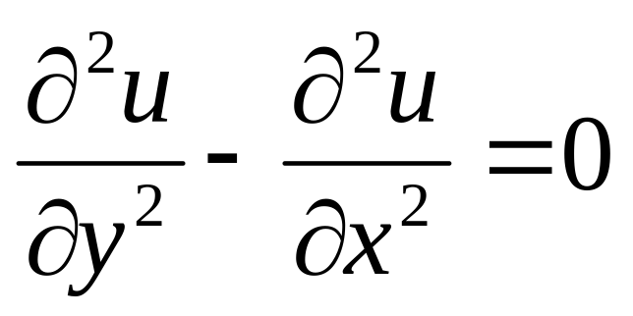
Differential Equations
Differential
Equations
Ordinary Differential Equations
involve one or more
Ordinary derivatives of
unknown functions
Partial Differential Equations
involve one or more
partial derivatives of
unknown functions

Slide 8
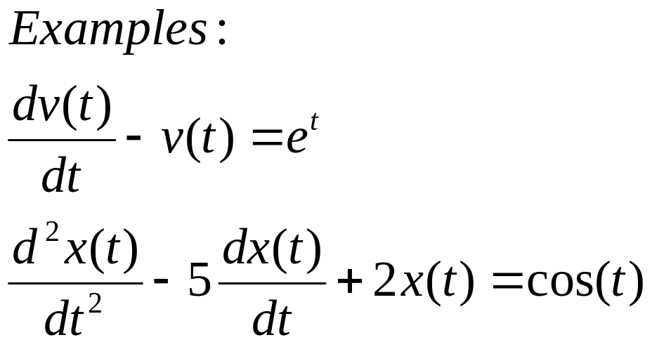
Ordinary Differential Equations
Ordinary Differential Equations (ODE) involve one or more ordinary derivatives of unknown functions with respect to one independent variable
x(t): unknown function
t: independent variable

Slide 9
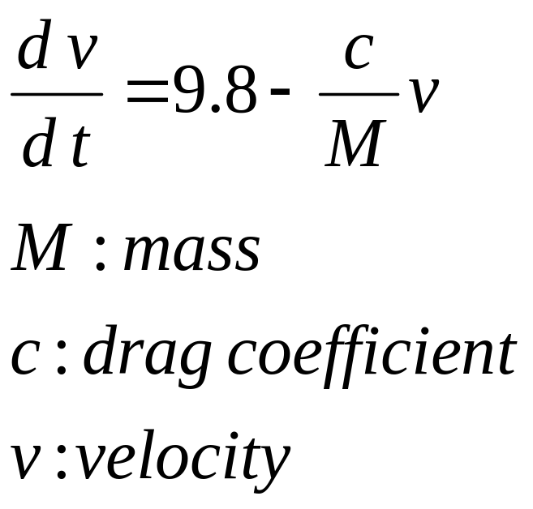
Example of ODE:
Model of falling parachutist
The velocity of a falling parachutist is given by

Slide 10
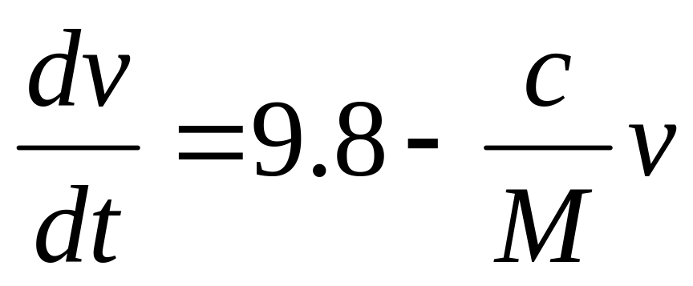
Definitions
Ordinary differential equation

Slide 11
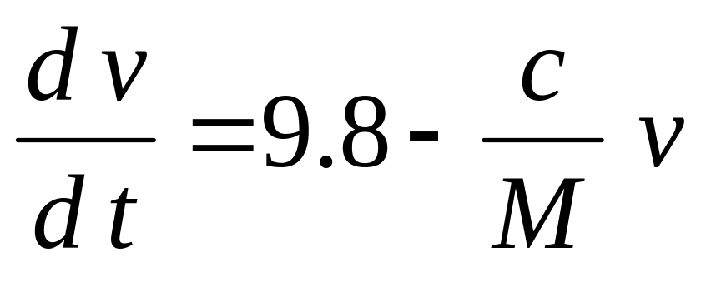
(Dependent variable) unknown function to be determined

Slide 12

(independent variable)
the variable with respect to which other variables are differentiated

Slide 13
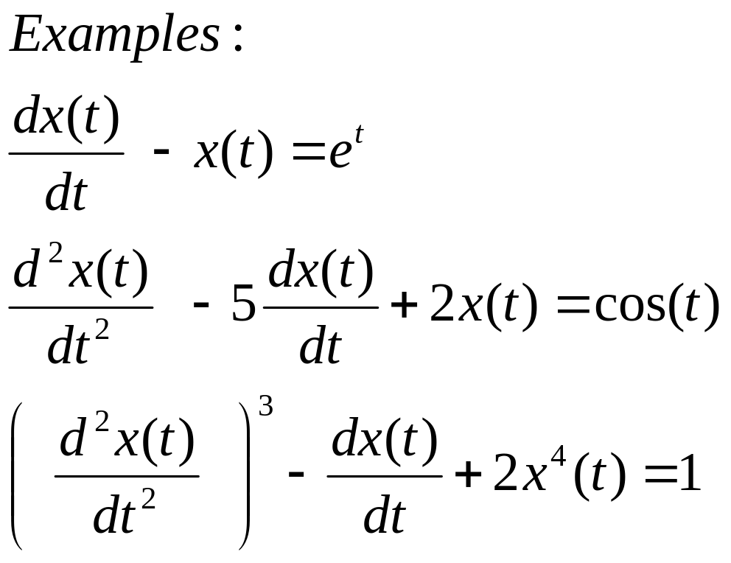
Order of a differential equation
The order of an ordinary differential equations is the order of the highest order derivative
First order ODE
Second order ODE
Second order ODE

Slide 14
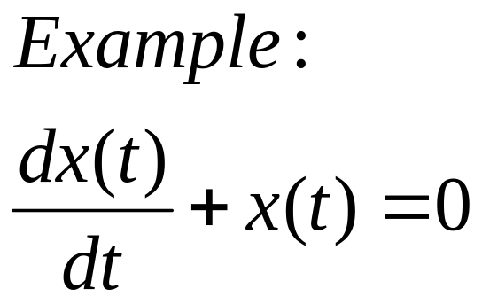
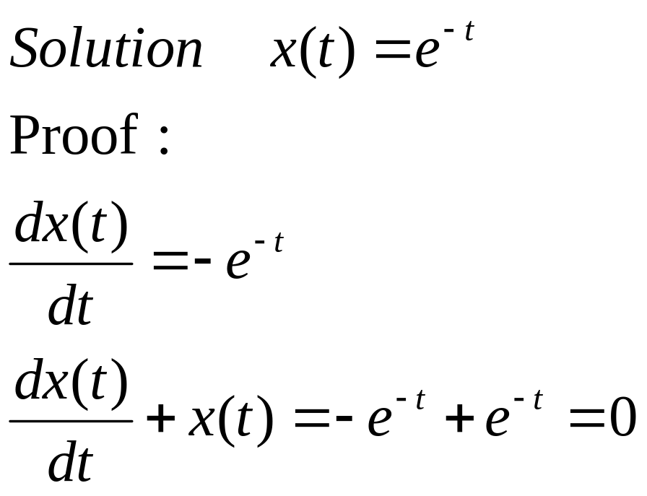
Solution of a differential equation
A solution to a differential equation is a function that satisfies the equation.

Slide 15
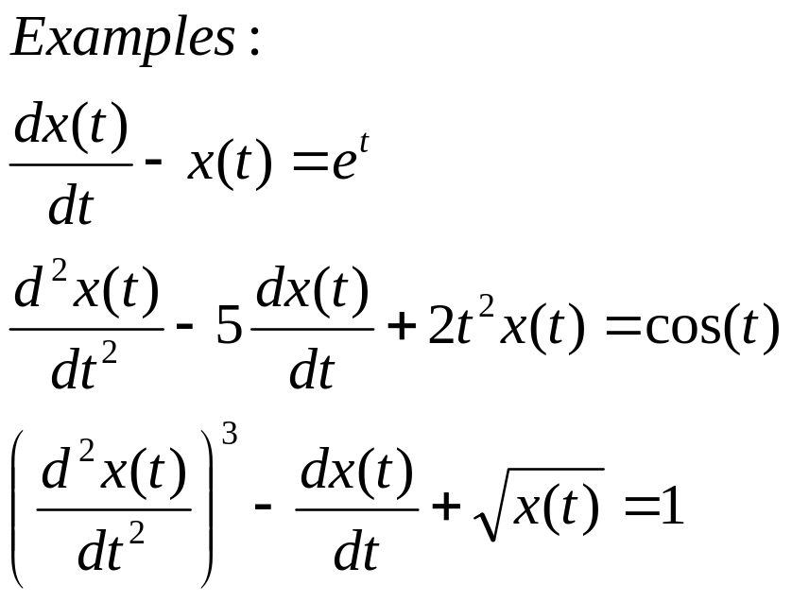
Linear ODE
An ODE is linear if
The unknown function and its derivatives appear to power one
No product of the unknown function and/or its derivatives
Linear ODE
Linear ODE
Non-linear ODE

Slide 16
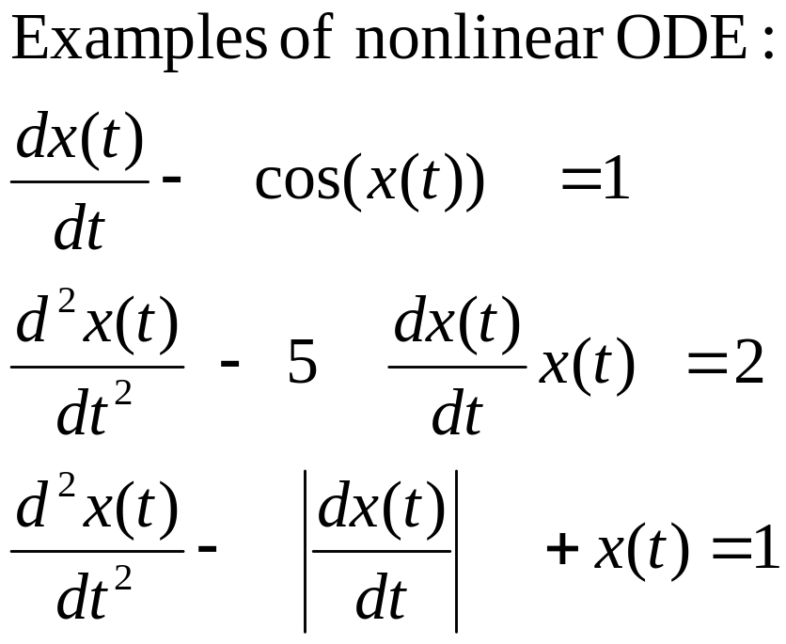
Nonlinear ODE
An ODE is linear if
The unknown function and its derivatives appear to power one
No product of the unknown function and/or its derivatives

Slide 17
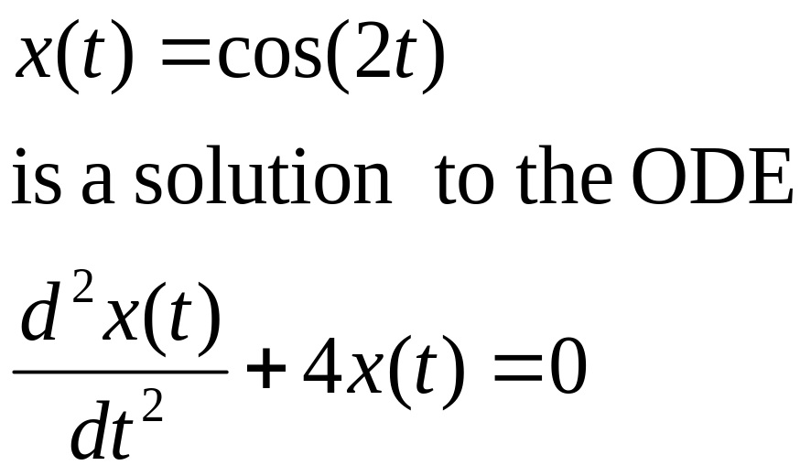
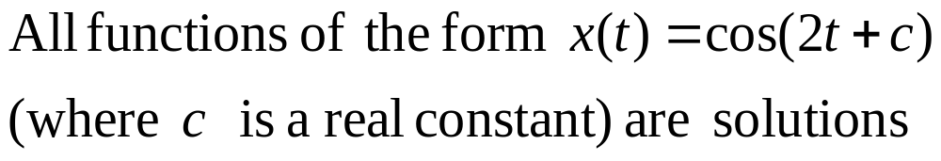
Solutions of Ordinary Differential Equations
Is it unique?

Slide 18
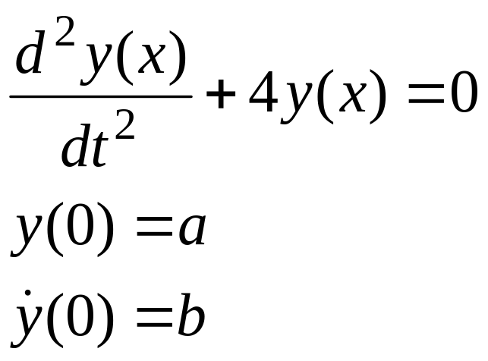
Uniqueness of a solution
In order to uniquely specify a solution to an n th order differential equation we need n conditions
Second order ODE
Two conditions are needed to uniquely specify the solution

Slide 19
AUXILIARY CONDITIONS
auxiliary conditions
Initial Conditions
all conditions are at one point of the independent variable
Boundary Conditions
The conditions are not at one point of the independent variable

Slide 20
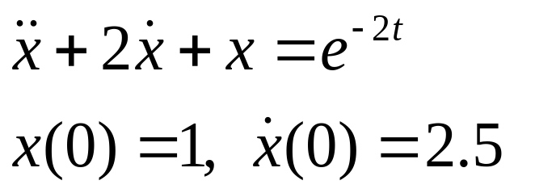
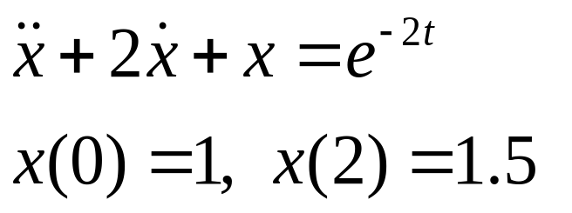
Boundary-Value and
Initial value Problems
Initial-Value Problems
The auxiliary conditions are at one point of the independent variable
Boundary-Value Problems
The auxiliary conditions are not at one point of the independent variable
More difficult to solve than initial value problem
same
different

Slide 21
Classification of ODE
ODE can be classified in different ways
Order
  First order ODE
  Second order ODE
  N^{th} order ODE
Linearity
  Linear ODE
  Nonlinear ODE
Auxiliary conditions
  Initial value problems
  Boundary value problems

Slide 22
ANALYTICAL SOLUTIONS
Analytical Solutions to ODE are available for linear ODE and special classes of nonlinear differential equations.

Slide 23
NUMERICAL SOLUTIONS
Numerical method are used to obtain a graph or a table of the unknown function
Most of the Numerical methods used to solve ODE are based directly (or indirectly) on truncated Taylor series expansion

Slide 24
CLASSIFICATION OF THE METHODS
Numerical Methods
for solving ODE
Single-Step Methods
Estimates of the solution at a particular step are entirely based on information on the previous step
Multiple-Step Methods
Estimates of the solution at a particular step are based on information on more than one step

Slide 25
More Lessons in this unit
Lesson 2: Taylor series methods
Lesson 3: Midpoint and Heun’s method
Lessons 4-5: Runge-Kutta methods
Lesson 6: Solving systems of ODE
Lesson 7: Multiple step Methods
Lesson 8-9: Boundary value Problems

Slide 26
SOLUTION OF ORDINARY DIFFERENTIAL EQUATIONS

Slide 27
LEARNING OBJECTIVES
Derive Euler formula using Taylor series expansion
Solve first order ODE using Euler method.
Assess the error level when using Euler method
Appreciate different types of error in numerical solution of ODE
Improve Euler method using higher-order Taylor Series.

Slide 28
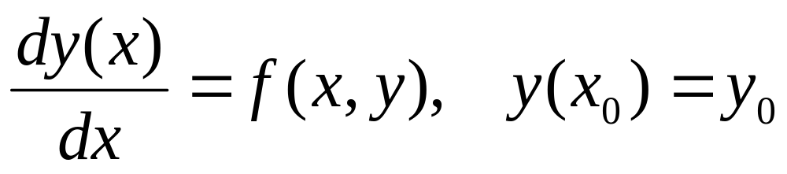
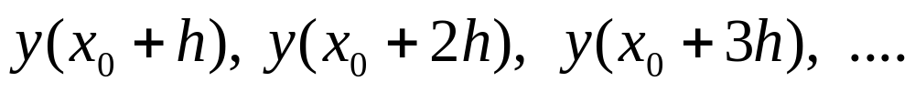
Taylor Series Method
The problem to be solved is a first order ODE
Estimates of the solution at different base points
are computed using truncated Taylor series
expansions

Slide 29
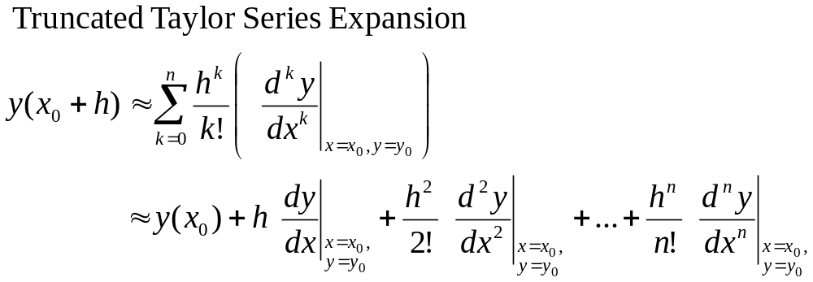
Taylor Series Expansion
n^{th} order Taylor series method uses n^{th} order Truncated Taylor series expansion

Slide 30
EULER METHOD
First order Taylor series method is known as Euler Method
Only the constant term and linear term are used in Euler method.
The error due to the use of the truncated Taylor series is of order O(h²).

Slide 31
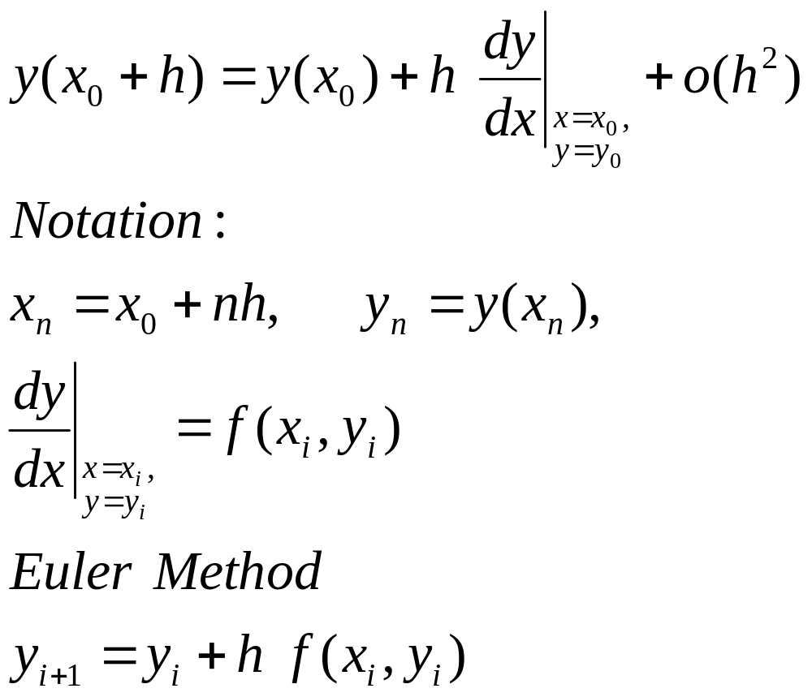
FIRST ORDER TAYLOR SERIES METHOD
(Euler Method)

Slide 32
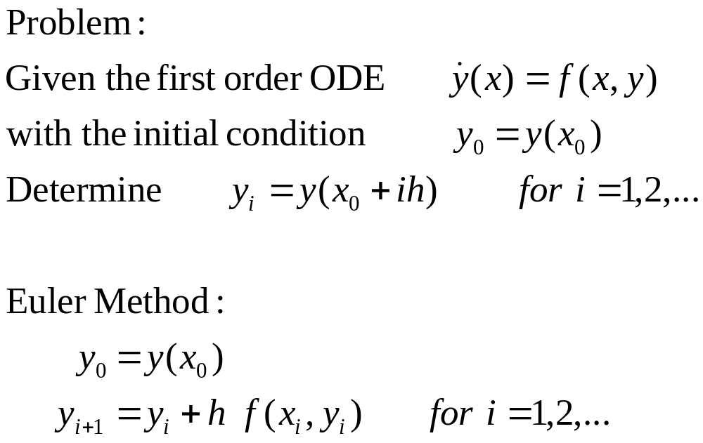
EULER METHOD

Slide 33
Interpretation of Euler Method
y₂
y₁
y₀
x₀ x₁ x₂ x

Slide 34
Interpretation of Euler Method
Slope=f(x₀,y₀)
y₁
y₁=y₀+hf(x₀,y₀)
hf(x₀,y₀)
y₀
x₀ x₁ x₂ x
h

Slide 35
Interpretation of Euler Method
y₂
y₂=y₁+hf(x₁,y₁)
Slope=f(x₁,y₁)
hf(x₁,y₁)
Slope=f(x₀,y₀)
y₁
y₁=y₀+hf(x₀,y₀)
hf(x₀,y₀)
y₀
x₀ x₁ x₂ x
h
h

Slide 36
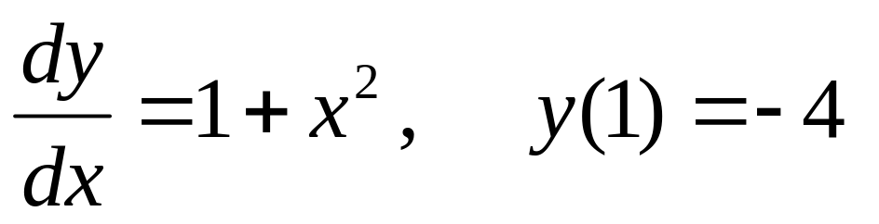
Example 1
Use Euler method to solve the ODE
to determine y(1.01), y(1.02) and y(1.03)

Slide 37
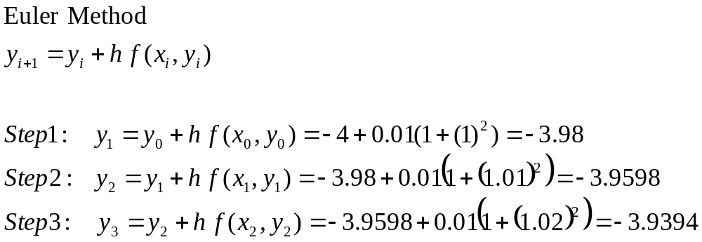
Example 1

Slide 38
Example 1
Summary of the result
i | xi | yi
0 | 1.00 | -4.00
1 | 1.01 | -3.98
2 | 1.02 | -3.9595
3 | 1.03 | -3.9394

Slide 39
Example 1
Comparison with true value
i | xi | yi | True value of yi
0 | 1.00 | -4.00 | -4.00
1 | 1.01 | -3.98 | -3.97996
2 | 1.02 | -3.9595 | -3.95959
3 | 1.03 | -3.9394 | -3.93091

Slide 40
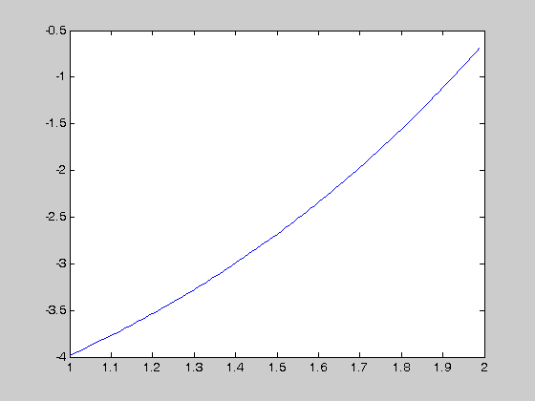
Example 1
A graph of the solution of the ODE for 1<x<2

Slide 41
Use Euler’s method to solve the I.V.P. dy/dt=(t-y)/2,on [0,3] with y(0)=1. Compare the solutions for h=1,1/2,1/4, and 1/8
t | h=1 | h=0.5 | h=0.25 | h=0.125
0 | 1.0 | 1.0 | 1.0 | 1.0
0.125 |  |  |  | 0.9375
0.25 |  |  | 0.825 | 0.886719
0.375 |  |  |  | 0.846924
0.50 |  | 0.75 | 0.796875 | 0.817429
0.75 |  |  | 0.759766 | 0.78680
1.00 | 0.5 | 0.6875 | 0.758545 | 0.790158
1.50 |  | 0.765625 | 0.846386 | 0.882855
2.00 | 0.75 | 0.949219 | 1.030827 | 1.068222
2.50 |  | 1.211914 | 1.289227 | 1.325176
3.00 | 1.375 | 1.533936 | 1.604252 | 1.637429

